Slide 1
To Successfully Implement Measures for “Deconfinement”
- Webinar -
Prepared by the diocesan committee for deconfinement
and the resumption of liturgical and pastoral activities
June 16, 2020

Slide 2

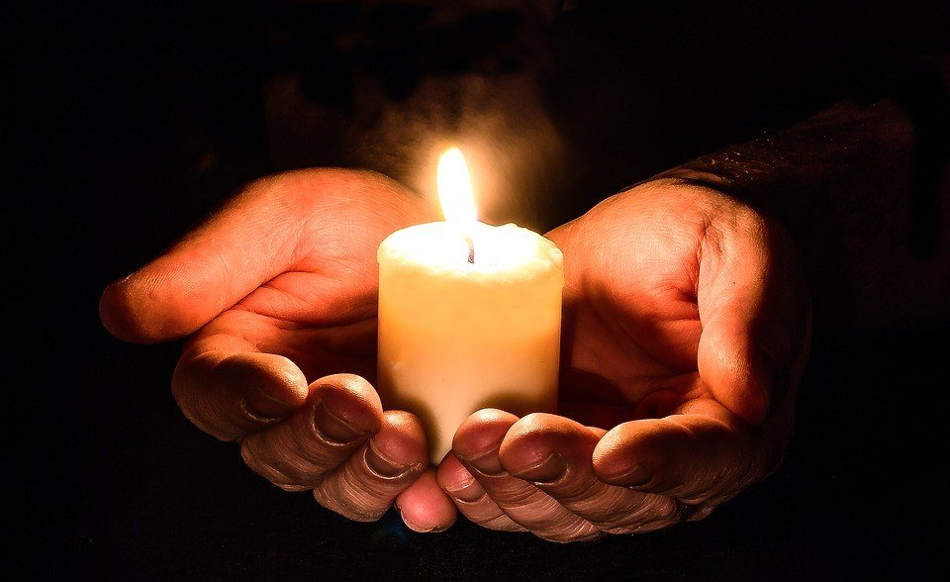
Prayer

Slide 3


Speakers
Mgr Christian Lépine, Archbishop of Montreal
  General spirit of deconfinement
Mgr Alain Faubert, VG
  Questions relating to pastoral structure
Laura Rochefort, Economist
  Financial questions

Slide 4

Committee Members
  Fr. Jean-Chrysostome Zoloshi, Pastor, Project Manager
  Fr. Jean-Pierre Couturier, Pastor, Marie Auxiliatrice Mission
  Ms Marie Hatem, PhD, Professor, School of Public Health, Université de Montréal
  Mr. Pierre Joannette, Permanent Deacon
  Fr. Claude Julien, Pastor, Pastor, Notre-Dame-de-Grâce Parish
  Fr. Bertrand Montpetit, Pastor, St-Luc/St. Luke Parish
  Ms Jeanine Morcos, Pastoral Agent, Bordeaux-Carterville
  Fr. Yves-Michel Touzi, Priest-in-charge, Notre-Dame-d’Haïti Mission
  Ms Marylène Valade, Assistant Director, Office for Pastoral Personnel

Slide 5
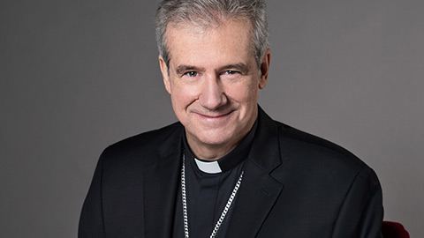
The Archbishop’s Message

Slide 6
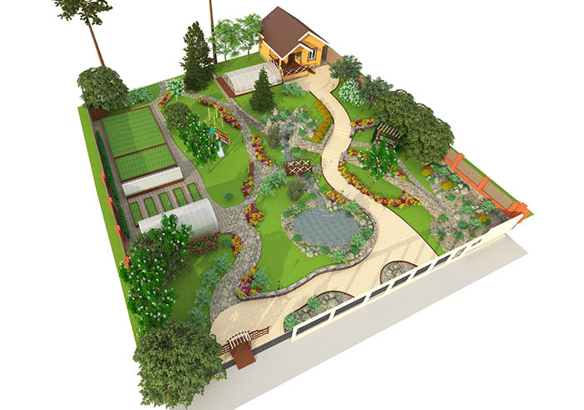
Agenda
Recent news on the deconfinement
Presentation of the tools (documentation)
Steps to follow in preparing the deconfinement
Sanitary and signaling equipment
The deconfinement phases
Questions/answers
Conclusion

Slide 7
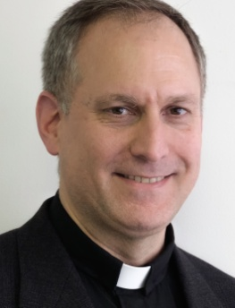

Recent news on the deconfinement
News

Slide 8

Tools Made Available For You
(Diocese website)
The roadmap for the deconfinement work
The protocole on the opening of church doors
The six Protocoles of the l’AÉCQ
The Guide for a successful implementation of the deconfinement
The FAQ

Slide 9
Steps to Follow in Preparing the Deconfinement
(Roadmap)
  Creating the local deconfinement committee
Step 1
  Collecting and assessing the parishes/missions/communities/groups context
Step 2
  Developing a deconfinement plan and procedures for parishes/missions/communities/groups
Step 3
  Implementing the deconfinement in parishes/missions/communities/groups
Step 4
Webinar on the deconfinement – June 16, 2020

Slide 10

Step 1
Create The Local Deconfinement Committee
Composition
The priest or his representative
The fabrique;
The pastoral committee;
The liturgical committee;
Catechism;
Baptisms, weddings, funerals;
Bible study or other groups;
Volunteers;
A parish respondent
Mandate
Assist in the development of protocols for the application of directives
Make the decisions
Provide training
Ensure the availability of human, material and financial resources
Webinar on the deconfinement – June 16, 2020

Slide 11
Step 2
Carry Out the Collection (planned tool)
ESSENTIAL INFORMATION
Number of parishioners who participate in the various activities and services offered by the parish
Characteristics of volunteers in general in each specific activity and service
Area (churches, halls, etc.)
The services offered by social and technological means (Zoom, Facebook, etc.)
Availability of resources used by the parish
Webinar on the deconfinement – June 16, 2020

Slide 12
Step 2 (continued)
Assess the Parishes/Missions/Communities/Groups Context
(Example)
AREAS FOR ASSESSMENT AND ADJUSTMENT | Decision | Training to be offered | Ressources
2.1 GENERAL CONDITIONS FOR ALL ACTIVITIES TAKING PLACE IN THE CHURCH
• Recourse to social media or online services: Zoom, Facebook, etc. (maintain, develop, collaborate, etc.)
• Celebrations that will be offered (type, number, etc.)
• Collaborate with a local parish to increase the number of celebrations…
• Calculate the number of participants for each celebration (take into account members of the same family)
• Arrangements associated with welcoming the faithful to celebrations (1st come-1st served basis; by alphabetical order, by rotation, by requesting tickets, etc.)
• Keeping the number of participants to no more that 50 percent capacity or less if necessary, in order to maintain a safe distance between the participants (See Appendix).
Webinar on the deconfinement – June 16, 2020

Slide 13
Step 2 (end)
Assess the Parishes/Missions/Communities/Groups Context
THE SPECIFIC CONDITIONS FOR THE DIFFERENT ACTIVITIES CARRIED OUT IN YOUR COMMUNITY (PARISH, MISSION, ETC.)
Masses
Funerals
Baptisms of children
Weddings
First Communions and Confirmations
Reconciliation
Catechisms
Bible study or other groups (the fabrique, the pastoral team, youth ministry, catechumens, etc.)
Webinar on the deconfinement – June 16, 2020

Slide 14
Step 3
Draw Up Your Local Deconfinement Plan
The areas of focus, regulations and other choices you plan to adopt for your parish/mission (1st column);
The elements chosen in point 1 (“Decisions” column) for which formation/training is necessary. List these elements (“Formation” column) according to the groups the training should target: committee members, celebrants, volunteers, faithful; and,
The resources – human, material, financial (“Resources” column) – necessary to put the various elements into place before resuming liturgical and pastoral activities in your parish/mission.
If you have any difficulties, please identify options or solutions that you think are relevant and sources from which you expect to receive support.
Webinar on the deconfinement – June 16, 2020

Slide 15
Step 4
  Implement the Deconfinement in Parishes/Missions/Communities/Groups
…In four stages:
Inform your parishioners about the new procedures in place and the changes that have been made;
Purchase the necessary equipment;
Offer training to volunteers;
Make the necessary changes: organize the physical spaces, materials, celebrations;
Webinar on the deconfinement – June 16, 2020

Slide 16

Inform your parishioners about the process
Webinar on the deconfinement – June 16, 2020

Slide 17
Sanitary and Signaling Equipment
(2 suppliers of signaling equipment)
(2 suppliers of sanitary equipment)
We have negotiated the best price!
The list (Signaling and Sanitary Equipment) can be found on the Diocese website: https://www.diocesemontreal.org/fr/ressources/personnel-pastoral
You can order directly from the suppliers, and have the ordered products delivered to you, based on your needs.

Slide 18

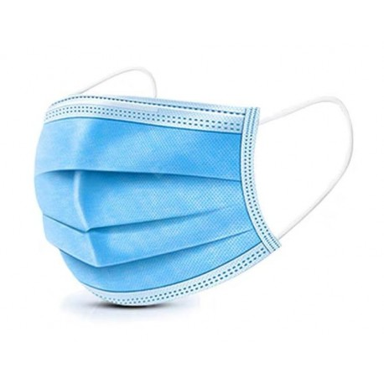
Sanitary and Signaling Equipment
(Example: suppliers -vs- products)
LALEMA
Quantity | Products |  |  |  | Unit | Price
1 | Disposable ear loop masks (50/box) |  |  |  | 29,00 $ | 29,00 $
1 | Powder-free vinyl examination gloves (100) |  |  |  | 13,90 $ | 13,90 $
4 | Refreshing Hand Lotion Manoxx 4L |  |  |  | 19,95 $ | 79,80 $
4 | Foam pump for 4L container |  |  |  | 5,95 $ | 23,80 $
1 | Desinfectant tuberculocide MYOSAN TB 4L |  |  |  | 18,95 $ | 18,95 $
 |  |  |  |  | 0,00 $ | 0,00 $
 |  |  |  |  | 0,00 $ | 0,00 $
 |  |  |  |  | Total | 165,45 $
ARTICLES DE SIGNALISATION
 |  |  |  |  | PDM |  | MP Repro
Quantité | Produits |  |  |  | unitaire | Prix | unitaire | Prix
2 | affiche LAVAGE DES MAINS |  |  |  | 5,00 $ | 10,00 $ | 4,32 $ | 8,64 $
2 | affiche RÈGLES DE SÉCURITÉ |  |  |  | 5,00 $ | 10,00 $ | 19,96 $ | 39,92 $
50 | FLÈCHES AU SOL |  |  |  | 3,50 $ | 175,00 $ | 2,78 $ | 139,00 $
3 | PASTILLES COMMUNION |  |  |  | 5,00 $ | 15,00 $ | 14,33 $ | 42,99 $
100 | MARQUE PLACE |  |  |  | 0,12 $ | 12,00 $ | 0,09 $ | 9,00 $
 | Manutention |  |  |  |  | 0,00 $ | 8,00 $ | 8,00 $
 | Rabais |  |  |  |  | 0,00 $ | 0,00 $ | (25,00 $)
 |  |  |  |  |  | 222,00 $ |  | 222,55 $
LALEMA: Fanny Daphnée Julien T: 514-645-2753 / C: service@lalema.com
MP Repro: T 514 861-8541 poste 268 ·/Sonia Fortin: sfortin@mprepro.com
PDM : Tél: 514-984-3031/Commande en ligne: affichecovid.ca/Pierre Durand : imppdm@videotron.ca

Slide 19
Sanitary and Signaling Equipment Focus on the Poster
To be placed at the entrance and at some strategic places within the church
Possibility of making bookmarks for large-scale distribution!

Slide 20
Social Distancing Inside the Church
An example

Slide 21
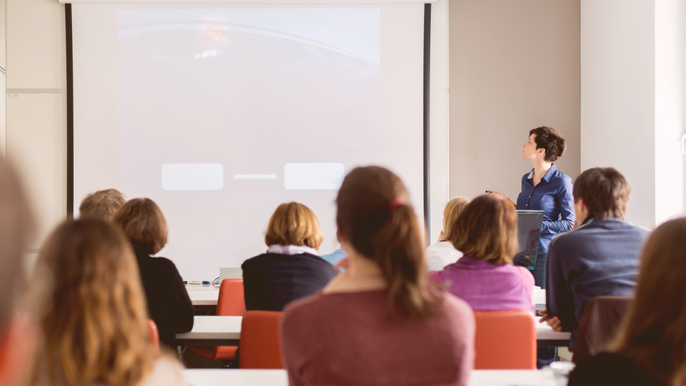

Offer Training to Volunteers…

Slide 22
https://www.youtube.com/watch?v=o8lOcHPYVTw

Slide 23


Slide 24
Complete the checklist and obtain authorisation from the Archbishop
Before moving on to Phase 1
The checklist (commitment form) will be available on the diocese website: https://www.diocesemontreal.org/fr/ressources/personnel-pastoral
Send your questions at: deconfinement@diocesemontreal.org
Please wait for the OK to start Phase 1 as well as Phase 2.

Slide 25
Step 4: Implement (…the stages)
by a gradual reopening in 4 stages…
Stage 1 : « Opening of the church doors »
Stage 2: « Events behind closed doors »
Stage 3: « Open but limited events »
Stage 4: « Back to normal »
Webinar on the deconfinement – June 16, 2020

Slide 26
QUESTIONS / ANSWERS
Webinar on the deconfinement – June 16, 2020

Slide 27
Conclusion
Important announcement: for further training
  a webinar will take place on June 25, from 7:30 to 9:00 pm
  45 min in French (7:30 to 8:15 pm)
  45 min in English (8:15 to 9:00 pm)
Informations from the VG
Prayer of the Archbishop
Webinar on the deconfinement – June 16, 2020

Slide 28
HAVE A GOOD DECONFINEMENT
Thank you!
Webinar on the deconfinement – June 16, 2020

